Slide 1

Roberto Freato – Consultant / Author / Solution Architect
Full-text search with Azure Search and SQL Database

Slide 2
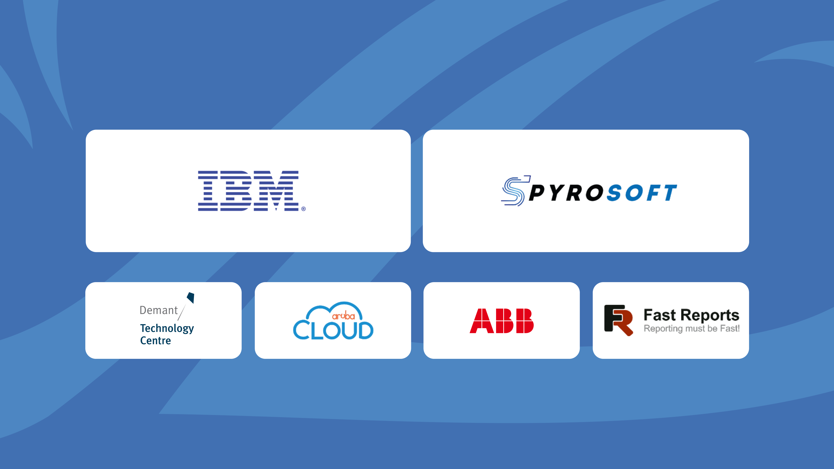
STRATEGIC SPONSORS
GOLD SPONSORS

Slide 3
DEMO
Amazon, Google Play

Slide 4
Old school
SELECT *
FROM [dbo].[Applications]
WHERE
(AppName like '%free%'
OR AppType=0)
AND AppSizeInKb>30000
AND AppCategory = 'GAME'
ORDER BY (AppRating*AppReviews) DESC
FREETEXT
FREETEXTTABLE
CONTAINS
CONTAINSTABLE

Slide 5
Search service
PseudoSyntax:
SEARCH ‘free’ INTO ALL THE SEARCHABLE FIELDS OF Document
With filtering
With automatic sorting on relevance
With manual sorting

Slide 6
Scenario
Open dataset taken on Kaggle
https://www.kaggle.com/lava18/google-play-store-apps
Splitted by “virtual tenant”
Cleaned and published into 2 separate DBs
(also) Preliminary code is available on GitHub:
https://github.com/childotg/Events.2019

Slide 7
Desired target
Make the relational data available for search
In a consolidated, single-point of view
With advanced search features (i.e. relevance sort)
Available via APIs

Slide 8
DEMO
Let’s do it

Slide 9
What’s happened
Azure portal Import Data Wizard
Fields enrichment via SQL Views
OData search queries
Scoring profiles
Data consolidation from different DBs
API Façade and Azure Search SDK
DEMOS and Slides available on GitHub:
https://github.com/childotg/Events.2019

Slide 10
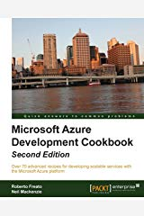

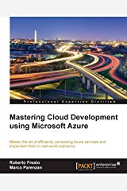

Roberto Freato – Consultant / Author / Solution Architect
Full-text search with Azure Search and SQL Database

Slide 11




Please rate this session using
Event Master
Mobile App
at the booth
in Lobby
login.developerdays.pl

Slide 12
STRATEGIC SPONSORS
GOLD SPONSORS

